Slide 1

water mesh
Christina Bandaragoda
SCGI-ESIP Bootcamp
November 6-7, 2019
Boulder Colorado

Slide 2
water mesh
clean water for everyone
SCGI-ESIP Bootcamp Napkin Drawing
HydroShare
Groups
household
drinking water samples
trusted private information

Slide 3
water mesh
clean water for everyone
SCGI-ESIP Bootcamp Napkin Drawing
HydroShare
Groups
household
drinking water samples
trusted community information

Slide 4
water mesh
clean water for everyone
SCGI-ESIP Bootcamp Napkin Drawing
HydroShare
Groups
household
drinking water samples
trusted public information

Slide 5
water mesh
online infrastructure for real-world health impacts
Data
chemistry
sediment
microbe contamination
upstream areas
climate data
terrain
households
Cyberinfrastructure
-code
-apps
-custom reports
Current State and Risk scenarios to Safe Drinking Water
Notes:
Change the color for scenarios?

Slide 6
SCGI-ESIP Value Proposition
We have targeting
water non-profit organizations with
a story-telling website,
expert reviewed articles,
and online training tools
to provide the value of
benchmarking
water quality improvements and risks.
Water mesh subscribers have access to online Apps that create custom drinking water reports that support households data providers and clean water infrastructure.

Slide 7
Zero install for water quality samples and earth data analysis and mapping.
Confidentiality of personal data
Code to aggregate and translate big time-sensitive private datasets to assessments of risk for public benefits.
SCGI-ESIP Bootcamp Value Proposition

Slide 8
Market landscape
SCGI-ESIP Bootcamp
Informed
Decisions & investments
Non-profit Local Recipes
industry
Risk Management
bespoke models
Government clearinghouse
tradition
Public benefit
“Democratization of data”
Legal Compliance
(Laws, Policy and Regulation, Ethics)

Slide 9
Scale-able Research Software for Earth informatics in Coupled Human-Nature Systems
SCGI-ESIP Bootcamp Market Landscape
Informed
Decisions & investments
Non-profit Local Recipes
Workspace engaged in evolving set of user-driven information products
industry
Risk Management
bespoke models
Current Academic Workspace
Advancing Physical Earth Science
Government clearinghouse
tradition
Public benefit
“Democratization of data”
Legal Compliance
(Laws, Policy and Regulation, Ethics)

Slide 10
water sector non-profits
SCGI-ESIP Bootcamp Target Audience
Data and Software Partners:
household data owners, academic water sampling campaign leads, research environmental engineers, public utilities operators, water sample & audit industry,

Slide 11
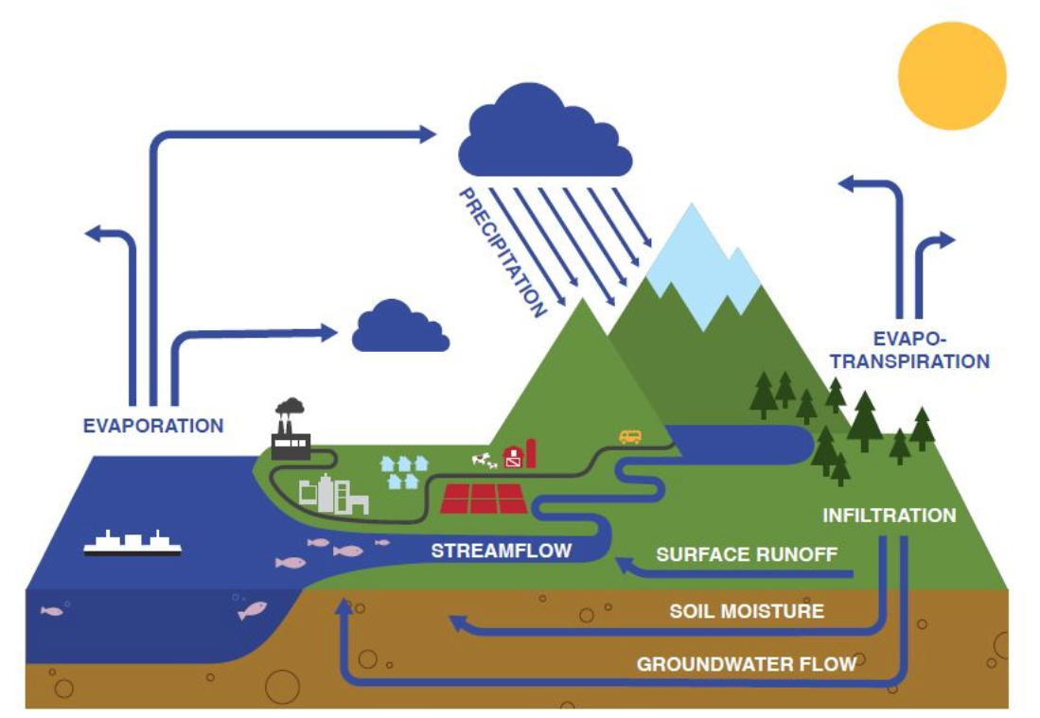
water mesh
online infrastructure model
private data asset
community repository
software tools
compute resources
risk management product
public benefit

Slide 12
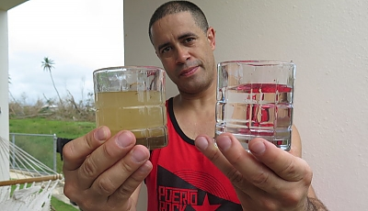
water mesh
Case Study 1
Situation: Puerto Rico’s infrastructure vulnerabilities were highlighted after Hurricane Maria hit the island in September 2017.

Slide 13
water mesh
Case Study 1
vulnerable drinking water
Drinking water samples
HydroShare Groups
Landlab Toolkit
CUAHSI JupyterHub
Drinking water report with source area geo-risk and hurricane risk synthesis.
Rural water systems and public utilities enabled to anticipate hurricane risk and comply with Safe Drinking Water Act.

Slide 14

water mesh
Case Study 2
Situation: Native American Tribes of the Pacific Northwest collect unique data assets critical for understanding environmental resources and critical endangered salmon habitat.
King Salmon Painting by Bob Patterson

Slide 15
water mesh
Case Study 2
tribal resource sovereignty
Earth and biological observations
HydroShare Groups
National BioGeographic Map
ESIPhub
Land cover scenario reports with environmental risk synthesis.
Government planning experts ensure democratic and balanced decision-making
King Salmon Painting by Bob Patterson

Slide 16
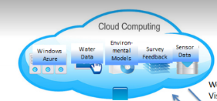
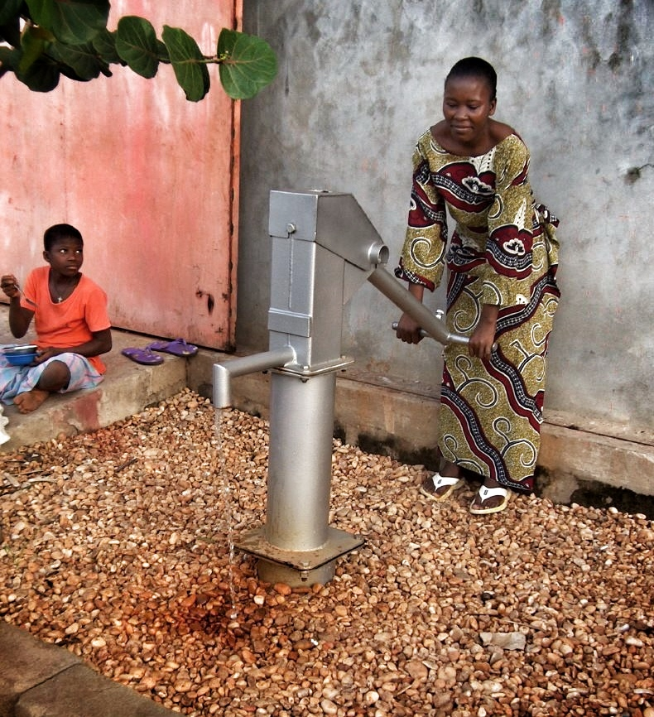
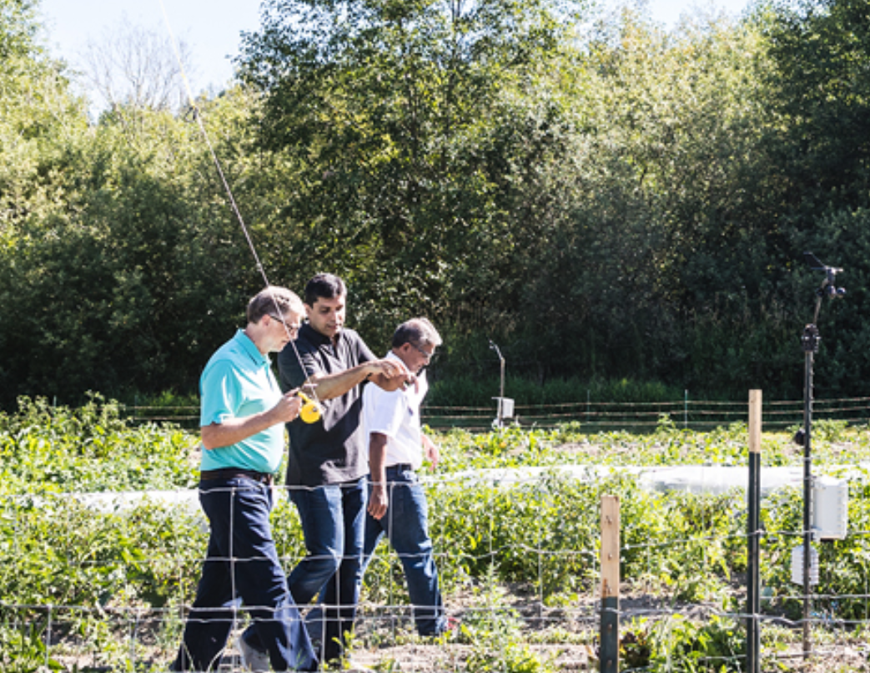

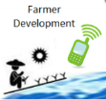
water mesh
Proposed Case Study 3
rural water supply & food
Situation: Agricultural decisions depend on water and crop risk maps developed with real-time data sources from farmers, sensors, ground & surface water, and satellites.

Slide 17
water mesh
Case Study 3
rural water supply & food
soil probe, crop cover, water supply - field scale distributed data
CropScape
Geoweaver
commercial cloud
real-time crop maps and water table level reports.
integrated risk management optimized to support farmers.

Slide 18
water mesh
SCGI-ESIP Bootcamp Financial Model
Licensed content data subscriptions
(Saas)
33%
Academic Grants
University In-Kind
33%
Endowment and Public Members
33%

Slide 19
tiered model
SCGI-ESIP Bootcamp Financial Model
Licensed content data subscriptions
(Saas)
33%
annual data subscription
$100,000 global non-profit
$ 10,000 local non-profit
$ 1,000 public utility, academic research
endowment
10 million
One-time Donation: $ 100
Annual recurrence: $10/year
Donors: 50,000
Endowment match: 5 million
Academic Grants
University In-Kind
33%
Endowment and Public Members
33%

Slide 20
water mesh - 3 months
develop prototype report for community water systems in Puerto Rico
pilot business model for household data owners trained in cyber & water treatment plant operations
present at Potable Water Symposium Feb, 2018; conduct user experience interviews with sample for local govt-wide scaling (from 6 to 240 utilities in PR)
SCGI-ESIP Bootcamp Goals

Slide 21
water mesh - 6 months
finalize prototype customizable reports for private and public
test business model for utility and private company data owners trained in cyber & water treatment plant operations
present at Natural Hazards Meeting July, 2019; conduct user experience interviews with sample for academic water campaign researchers for international scaling
SCGI-ESIP Bootcamp Goals

Slide 22
water mesh

